Slide 1
Naturally Organic Slim & Healthy,
RO’s Carb-cutting Kick Start:
RADIANT HEALTH FROM REAL FOOD

Slide 2
Oxalate Awareness

Slide 3
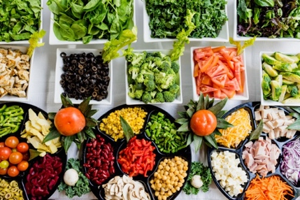
Picture of Health?
Notes:
Have you heard of oxalic acid, oxalate salts or oxalate crystals? Collectively, they are known as Oxalates. Oxalates are natural toxins which are used by plants to defend themselves against infections, fungus and plant eating animals. However, in the process of defending themselves, they can actually cause us harm. Personally, I know about this as I am recovering from an overload which caused issues with my hair, nails, skin and general inflammation in my body.
Oxalic acid binds to minerals such as calcium and forms crystals with the form of rough sand, diamonds, pyramids and needles with barbed tips known as Raphides. Raphides are designed to carry poison as they pucture cells in the mouth, throat and intestines. They also deplete magnesium from the body which prevents the cells from using glucose.

Slide 4
Hair & nail breakages, skin issues Deplete Minerals Kidney issues Joint & muscle pain Indigestion Fatigue Genital and urinary Cardiovascular disease Cancer
Health Challenges
Notes:
Hair loss, nail breakages, skin issues
Deplete Calcium and Magnesium => heart Arrythmia, osteoporosis
Kidney Stones and kidney failure
Joint & muscle pain, athritis
Indigestion - Reflux, hiccups, bloating
Fatigue, brain fog, poor sleep, low moods
Slow healing
Genital and urinary tract problems
Cardiovascular disease
Cancer
This list is not comprehensive. Everyone is different and we can be impacted in many different ways depending on the toxicity level and our body’s ability to deal with it. Some people have more Oxalobacter bacteria which can break down oxalates but it has disappeared in many people.

Slide 5
Where?
Amaranth
Buckwheat family
Seeds
Most tree nuts
Night Shades / Solanacea
Notes:
Where do you find them?
Amaranth family: spinach, chard, lamb’s lettuce, amaranth, quinoa, beets and their leafy green tops
Buckwheat family including rhubarb
Seeds; Chia, poppy, sesame, hemp
Most tree nuts: Almonds, especially with skin, cashews, pine nuts
Night Shades / Solanacea: Potatoes, aubergines, tomatoes, peppers. Red peppers are low but others are high.

Slide 6
Others
Beans (including cocoa)
Teff, wholegrains
Spices
Herbs
Oxalate producing mould
Fruit: Star Fruit, blackberries, figs
Notes:
Beans (including cocoa), teff, wholegrains
Spices such as cinnamon, turmeric, black pepper, ginger, allspice, cumin
Herbs such as parsley and basil
Oxalate producing mould: Aspergillus and Penicillium. These impact wheat flours, dried and fresh fruit.
Star Fruit, blackberries, figs - 500ml of Star Fruit Juice can kill

Slide 7
150-200mg per day. In perspective, approx: 90g boiled spinach = 450mg 110g sweet potato = 120mg 20g chia seeds = 130mg ½ tsp turmeric = 25mg 28g whole almonds = 120mg 2 tbsps cocoa = 80mg
Safe level
Notes:
Safe level
Is there a safe level? 150-200mg per day. To put this in perspective, approximately:
90g boiled spinach = 450mg, more than twice the safe level
110g sweet potato = 120mg
20g chia seeds = 130mg
½ tsp turmeric = 25mg
28g whole almonds = 120mg
2 tbsps cocoa = 80mg

Slide 8
Safer Options
Brassica Family
Collards, Kale (not curly)
Watercress
Radish
Turnips
White Pepper
Notes:
Safer Options:
Brocoli, Cauliflower, Rocket,
Mustard greens, Collards, Kale (not curly)
Watercress
Radish
Turnips
White Pepper

Slide 9
Oxalate Drivers
Gastric Bypass
Vitamin C in Excess
Anti-inflammatories
Ethylene glycol
Juices, smoothies, nut milks
Collagen supplements
Glyoxal
Oxidative Stress
Drugs
Notes:
Oxalate Drivers
Gastric Bypass
Vitamin C in Excess
Anti-inflammatories; ibuprofen, paracetamol
Ethylene glycol – used in Nando’s sauces
Juices, smoothies, nut milks- break down cell walls releasing more oxalates
Collagen supplements
Glyoxal- anti-microbial product used in cosmetics to create formaldehyde
Oxidative Stress
Drugs: Lexapro - for anxiety. Oxaliplatin - chemo

Slide 10
Diffenbachia House Plant Hunters
Interesting Facts
Notes:
Diffenbachia house plants, also known as Dumb Cane can actually propel raphide crystals into the air and cause histamine reactions and temporary paralysis of vocal cords. This is where the name Dumb Cane comes from.
Hunters used to drive their arrowheads into banana trunks before hunting as it paralyses prey. It is a neurotoxin.

Slide 11
Pesticide for beekeepers Stop green veg yellowing Salts of Lemon Etching & polishing in engraving Laundry powder Ethylene glycol Food and drink flavouring Test blood glucose
Human Use of Oxalates
Notes:
Human Use of Oxalates
As a pesticide for beekeepers
To stop green veg yellowing
Hunters used to drive their arrowheads into banana trunks before hunting as it paralyses prey. It is a neurotoxin.
Originally called Salts of Lemon. Used in the past to remove ink stains and to prepare cotton by cotton producers – bleach and dye fixative
Etching and polishing in engraving
Laundry powder- Essential salts of lemon. Still used in some cleaning products
Ethylene glycol – used for cleaning in the brewing industry
Was even added to foods and drinks to impart a ‘lemony’ taste
Potassium oxalate used to test blood glucose levels -binds to magnesium to isolate the glucose.

Slide 12
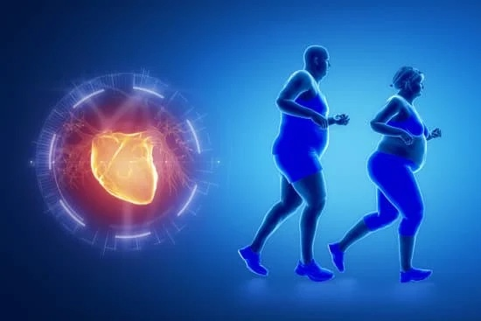
Adopt a low-oxalate diet - gradually Avoid the Pre-cursors Saunas Cold Therapy Mineral Supplements – calcium, potassium, magnesium, salt
Recovery
Notes:
Recovery
Adopt a low-oxalate diet - gradually
Avoid the Pre-cursors
Saunas
Cold Therapy
Mineral Supplements – calcium, potassium, magnesium, salt

Slide 13
Summary
Slow and easy
Sally Norton’s book
Anthony Chaffee
Richard Smith of Keto Pro
You are unique - do your own research
Notes:
Take it slow and easy. I cannot recommend Sally Norton’s, Toxic Superfoods book enough. You can also find her resources on Youtube. Anthony Chaffee is another proponent of the low-oxalate way of eating.
A UK shining example is Richard Smith of Keto Pro. He reversed his obesity, type 2 diabetes, food addictions and became UK and European Body Building champion using Real Food.
Everyone is unique so it is important to do your own research.

Slide 14
Q & A

